Slide 1
VOTING FOR RIGHT-WING POPULIST PARTIES: NATIVE AND FOREIGN-BORN SUBPOPULATIONS ………………………………………………………………………………………..
Data Science for Business Analytics
Prof. Thibault Vatter
Shane Johnson and Emna El May
POSM Students
20th August 2019

Slide 2
Project Description
Aim to analyse the factors involved in voting for Right-Wing populist parties for native- and foreign-born populations.
Uses ESS 2016 Survey data to build logistic regression models of the probability to vote RWP to see what factors explain this, and investigate the differences.
Give insight into the ‘hot topic’ that is the ascendance of RWP around the world by identifying varying factors that contribute towards it popularity, especially in the under-researched topics of immigrants voting RWP.

Slide 3
Motivation & Theory
Past studies : “Social Psychology of Opinion Formation” (Prof. Staerklé - UNIL) → Personal interest for Right Wing Populism and factors that promote their current rise.
The existing literature suggests that the following factors tend to impact the probability to vote for RWP parties among native population :
Men, low income, low level of education, low GDP, live in rural regions, feel materially and/or symbolically threatened
Findings on the impact of age are contradictory.
Percentage of immigrants in country either promote (contact theory) or impede (threat theory) votes for RWP.
⇒ We are interested here to investigate whether those factors also predict votes for RWP among among immigrant population.To our knowledge, no existing literature addressed this issue yet.

Slide 4
Data
European Social Survey data from 2016.
44,387 cases over 534 variables
Variables, such as: “Born in country”, “Party voted for in last national election”, “Household income decile”, “Whether one thinks immigrants worsen the economy”
We thus filtered down the data frame to countries who have a RWP party (this ruled out Spain and Ireland in 2016)
Created new variable on whether the individual voted for the countries RWP party, based on their vote in the last national election.
Also, merged data from the World Bank on national-level variables such as GDP per capita and Urban/Rural populations.

Slide 5
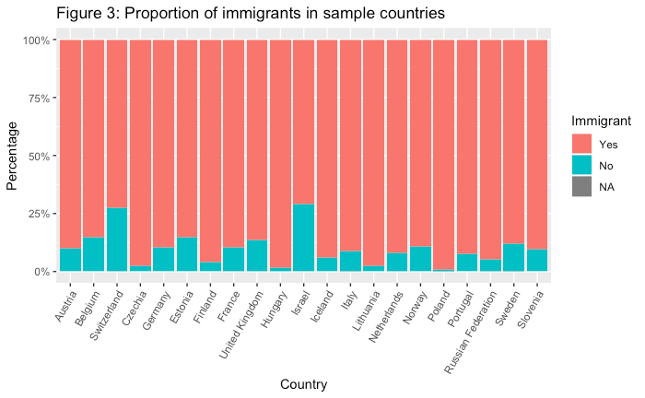
Exploratory Analysis
Proportion of immigrants and natives

Slide 6
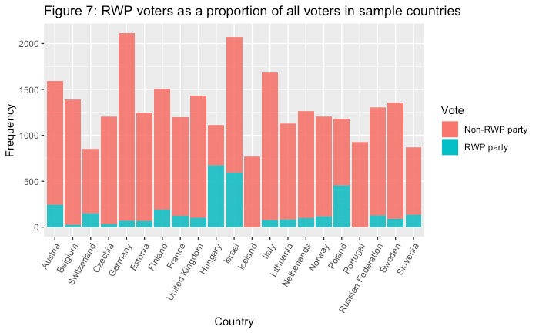
Exploratory Analysis
RWP voters relativity per country

Slide 7
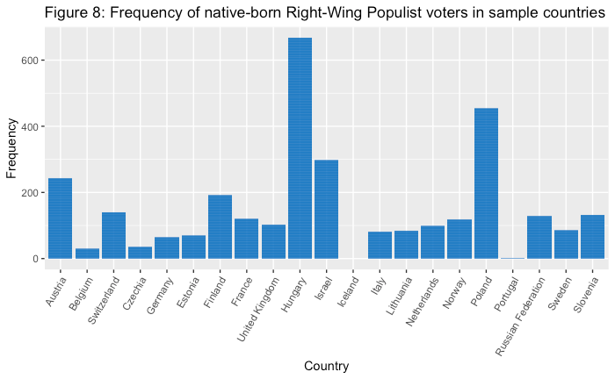
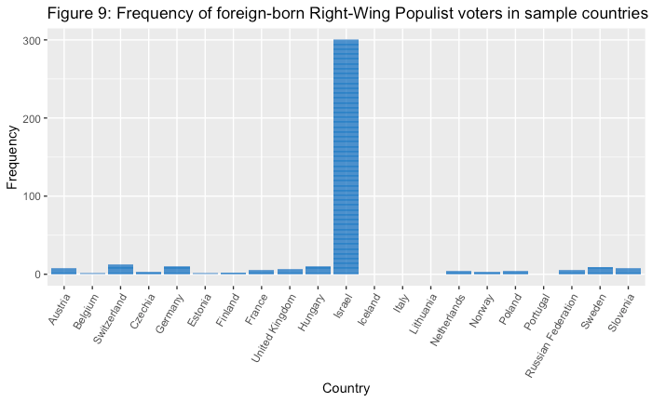
Exploratory Analysis
RWP voters in both subpopulations

Slide 8
Models and Findings
Logistic regressions for both sub-populations

Slide 9
Independent Variables used in modelling
Age
Gender
Education
Household income decile (Proxy for income level)
Material threat
Symbolic threat
GDP in 2016
Average GDP growth over last 5 years
Urban/Rural population ratio
Percentage of immigrants in population

Slide 10
Native model
 | Model 1 | Model 2 | Model 3 | Model 4
(Intercept) | -2.57 *** | -2.55 *** | -2.56 *** | -2.59 ***
 | (0.14) | (0.14) | (0.14) | (0.12)
AGECAT2 | 0.11 | 0.11 | 0.11 | 0.04
 | (0.07) | (0.07) | (0.07) | (0.07)
AGECAT3 | 0.16 * | 0.15 * | 0.15 * | 0.11
 | (0.07) | (0.07) | (0.07) | (0.07)
AGECAT4 | -0.05 | -0.06 | -0.06 | -0.07
 | (0.08) | (0.08) | (0.08) | (0.07)
gndr | -0.36 *** | -0.36 *** | -0.36 *** | -0.32 ***
 | (0.05) | (0.05) | (0.05) | (0.05)
eiscedLS2 | 0.52 *** | 0.51 *** | 0.51 *** | 0.62 ***
 | (0.12) | (0.12) | (0.12) | (0.11)
eiscedLUS3 | 0.47 *** | 0.46 *** | 0.47 *** | 0.59 ***
 | (0.12) | (0.12) | (0.12) | (0.11)
eiscedUUS4 | 0.27 * | 0.26 * | 0.26 * | 0.34 **
 | (0.12) | (0.12) | (0.12) | (0.12)
eiscedAV5 | -0.08 | -0.08 | -0.08 | 0.03
 | (0.13) | (0.13) | (0.13) | (0.12)
eiscedBA6 | -0.04 | -0.04 | -0.04 | 0.12
 | (0.15) | (0.15) | (0.15) | (0.13)
eiscedMA7 | -0.27 | -0.27 | -0.27 | -0.22
 | (0.14) | (0.14) | (0.14) | (0.13)
eiscedOther8 | -0.69 | -0.70 | -0.69 | -0.02
 | (1.03) | (1.03) | (1.03) | (0.74)
hinctntaR - 2nd decile | 0.06 | 0.06 | 0.06
 | (0.11) | (0.11) | (0.11)
hinctntaC - 3rd decile | 0.04 | 0.04 | 0.04
 | (0.11) | (0.11) | (0.11)
hinctntaM - 4th decile | 0.06 | 0.06 | 0.06
 | (0.11) | (0.11) | (0.11)
hinctntaF - 5th decile | 0.07 | 0.06 | 0.06
 | (0.11) | (0.11) | (0.11)
hinctntaS - 6th decile | 0.04 | 0.03 | 0.03
 | (0.11) | (0.11) | (0.11)
hinctntaK - 7th decile | 0.09 | 0.08 | 0.08
 | (0.12) | (0.11) | (0.11)
hinctntaP - 8th decile | 0.03 | 0.02 | 0.02
 | (0.12) | (0.12) | (0.12)
hinctntaD - 9th decile | -0.10 | -0.11 | -0.11
 | (0.14) | (0.14) | (0.14)
hinctntaH - 10th decile | -0.06 | -0.08 | -0.07
 | (0.15) | (0.15) | (0.15)
GDPpc2016 | -0.02 | 0.01
 | (0.04) | (0.03)
GDPpc.5yeargrowth | 0.16 *** | 0.16 *** | 0.16 *** | 0.22 ***
 | (0.03) | (0.03) | (0.02) | (0.02)
percentage.immigrant | 0.05
 | (0.03)
ratioUR | -0.29 *** | -0.28 *** | -0.28 *** | -0.23 ***
 | (0.04) | (0.04) | (0.04) | (0.04)
materialthreat | 0.26 *** | 0.26 *** | 0.26 *** | 0.28 ***
 | (0.03) | (0.03) | (0.03) | (0.03)
symbolicthreat | 0.20 *** | 0.20 *** | 0.20 *** | 0.17 ***
 | (0.03) | (0.03) | (0.03) | (0.03)
N | 20002 | 20002 | 20002 | 23098
AIC | 11300.81 | 11301.27 | 11299.32 | 13160.50
BIC | 11514.21 | 11506.76 | 11496.91 | 13289.26
Pseudo R2 | 0.07 | 0.07 | 0.07 | 0.07
*** p < 0.001; ** p < 0.01; * p < 0.05.

Slide 11
Native model
 | Model 1 | Model 2 | Model 3 | Model 4
(Intercept) | -2.57 *** | -2.55 *** | -2.56 *** | -2.59 ***
 | (0.14) | (0.14) | (0.14) | (0.12)
AGECAT2 | 0.11 | 0.11 | 0.11 | 0.04
 | (0.07) | (0.07) | (0.07) | (0.07)
AGECAT3 | 0.16 * | 0.15 * | 0.15 * | 0.11
 | (0.07) | (0.07) | (0.07) | (0.07)
AGECAT4 | -0.05 | -0.06 | -0.06 | -0.07
 | (0.08) | (0.08) | (0.08) | (0.07)
gndr | -0.36 *** | -0.36 *** | -0.36 *** | -0.32 ***
 | (0.05) | (0.05) | (0.05) | (0.05)
eiscedLS2 | 0.52 *** | 0.51 *** | 0.51 *** | 0.62 ***
 | (0.12) | (0.12) | (0.12) | (0.11)
eiscedLUS3 | 0.47 *** | 0.46 *** | 0.47 *** | 0.59 ***
 | (0.12) | (0.12) | (0.12) | (0.11)
eiscedUUS4 | 0.27 * | 0.26 * | 0.26 * | 0.34 **
 | (0.12) | (0.12) | (0.12) | (0.12)
eiscedAV5 | -0.08 | -0.08 | -0.08 | 0.03
 | (0.13) | (0.13) | (0.13) | (0.12)
eiscedBA6 | -0.04 | -0.04 | -0.04 | 0.12
 | (0.15) | (0.15) | (0.15) | (0.13)
eiscedMA7 | -0.27 | -0.27 | -0.27 | -0.22
 | (0.14) | (0.14) | (0.14) | (0.13)
eiscedOther8 | -0.69 | -0.70 | -0.69 | -0.02
 | (1.03) | (1.03) | (1.03) | (0.74)
hinctntaR - 2nd decile | 0.06 | 0.06 | 0.06
 | (0.11) | (0.11) | (0.11)
hinctntaC - 3rd decile | 0.04 | 0.04 | 0.04
 | (0.11) | (0.11) | (0.11)
hinctntaM - 4th decile | 0.06 | 0.06 | 0.06
 | (0.11) | (0.11) | (0.11)
hinctntaF - 5th decile | 0.07 | 0.06 | 0.06
 | (0.11) | (0.11) | (0.11)
hinctntaS - 6th decile | 0.04 | 0.03 | 0.03
 | (0.11) | (0.11) | (0.11)
hinctntaK - 7th decile | 0.09 | 0.08 | 0.08
 | (0.12) | (0.11) | (0.11)
hinctntaP - 8th decile | 0.03 | 0.02 | 0.02
 | (0.12) | (0.12) | (0.12)
hinctntaD - 9th decile | -0.10 | -0.11 | -0.11
 | (0.14) | (0.14) | (0.14)
hinctntaH - 10th decile | -0.06 | -0.08 | -0.07
 | (0.15) | (0.15) | (0.15)
GDPpc2016 | -0.02 | 0.01
 | (0.04) | (0.03)
GDPpc.5yeargrowth | 0.16 *** | 0.16 *** | 0.16 *** | 0.22 ***
 | (0.03) | (0.03) | (0.02) | (0.02)
percentage.immigrant | 0.05
 | (0.03)
ratioUR | -0.29 *** | -0.28 *** | -0.28 *** | -0.23 ***
 | (0.04) | (0.04) | (0.04) | (0.04)
materialthreat | 0.26 *** | 0.26 *** | 0.26 *** | 0.28 ***
 | (0.03) | (0.03) | (0.03) | (0.03)
symbolicthreat | 0.20 *** | 0.20 *** | 0.20 *** | 0.17 ***
 | (0.03) | (0.03) | (0.03) | (0.03)
N | 20002 | 20002 | 20002 | 23098
AIC | 11300.81 | 11301.27 | 11299.32 | 13160.50
BIC | 11514.21 | 11506.76 | 11496.91 | 13289.26
Pseudo R2 | 0.07 | 0.07 | 0.07 | 0.07
*** p < 0.001; ** p < 0.01; * p < 0.05.

Slide 12
Immigrant model
 | Model 1 | Model 2 | Model 3 | Model 4
(Intercept) | -3.37 *** | -3.38 *** | -3.18 *** | -3.30 ***
 | (0.39) | (0.39) | (0.36) | (0.30)
AGECAT2 | 0.52 | 0.53 | 0.53 * | 0.57 *
 | (0.29) | (0.29) | (0.27) | (0.27)
AGECAT3 | 0.82 ** | 0.82 ** | 0.73 ** | 0.77 **
 | (0.27) | (0.27) | (0.25) | (0.25)
AGECAT4 | 0.65 * | 0.67 * | 0.54 * | 0.61 *
 | (0.26) | (0.26) | (0.25) | (0.24)
gndr | 0.36 * | 0.37 * | 0.33 * | 0.32 *
 | (0.16) | (0.16) | (0.16) | (0.15)
eiscedLS2 | -0.62 | -0.60 | -0.40
 | (0.38) | (0.38) | (0.34)
eiscedLUS3 | 0.19 | 0.23 | 0.09
 | (0.30) | (0.30) | (0.28)
eiscedUUS4 | 0.06 | 0.08 | -0.09
 | (0.32) | (0.32) | (0.30)
eiscedAV5 | 0.37 | 0.40 | 0.33
 | (0.31) | (0.31) | (0.29)
eiscedBA6 | -0.54 | -0.52 | -0.70 *
 | (0.35) | (0.35) | (0.34)
eiscedMA7 | -0.12 | -0.10 | -0.18
 | (0.33) | (0.33) | (0.31)
eiscedOther8 | -12.17 | -12.29 | -12.39
 | (357.52) | (360.23) | (337.17)
hinctntaR - 2nd decile | 0.02 | 0.02 | -0.03 | -0.03
 | (0.25) | (0.25) | (0.24) | (0.24)
hinctntaC - 3rd decile | -0.26 | -0.27 | -0.35 | -0.38
 | (0.28) | (0.28) | (0.27) | (0.27)
hinctntaM - 4th decile | -0.50 | -0.50 | -0.48 | -0.46
 | (0.31) | (0.31) | (0.29) | (0.28)
hinctntaF - 5th decile | -0.50 | -0.51 | -0.51 | -0.47
 | (0.33) | (0.33) | (0.32) | (0.31)
hinctntaS - 6th decile | -0.49 | -0.52 | -0.48 | -0.49
 | (0.37) | (0.37) | (0.34) | (0.34)
hinctntaK - 7th decile | 0.19 | 0.19 | 0.08 | -0.02
 | (0.34) | (0.34) | (0.33) | (0.32)
hinctntaP - 8th decile | -0.23 | -0.24 | -0.26 | -0.35
 | (0.39) | (0.39) | (0.38) | (0.37)
hinctntaD - 9th decile | -1.32 * | -1.33 * | -1.16 * | -1.21 *
 | (0.65) | (0.65) | (0.58) | (0.57)
hinctntaH - 10th decile | -1.05 | -1.05 | -1.18 * | -1.25 *
 | (0.58) | (0.58) | (0.57) | (0.56)
GDPpc2016 | -0.96 *** | -0.93 *** | -0.94 *** | -0.93 ***
 | (0.13) | (0.13) | (0.12) | (0.12)
GDPpc.5yeargrowth | -0.50 *** | -0.47 *** | -0.44 *** | -0.42 ***
 | (0.12) | (0.12) | (0.12) | (0.11)
percentage.immigrant | 1.53 *** | 1.49 *** | 1.53 *** | 1.51 ***
 | (0.11) | (0.10) | (0.10) | (0.10)
ratioUR | -0.14
 | (0.13)
materialthreat | 0.13 | 0.13 | 0.22 ** | 0.24 **
 | (0.09) | (0.09) | (0.08) | (0.07)
symbolicthreat | 0.12 | 0.13
 | (0.10) | (0.10)
N | 2334 | 2334 | 2536 | 2546
AIC | 1152.14 | 1151.50 | 1252.63 | 1257.06
BIC | 1307.54 | 1301.14 | 1398.59 | 1362.22
Pseudo R2 | 0.36 | 0.36 | 0.36 | 0.35
*** p < 0.001; ** p < 0.01; * p < 0.05.

Slide 13
Immigrant model
 | Model 1 | Model 2 | Model 3 | Model 4
(Intercept) | -3.37 *** | -3.38 *** | -3.18 *** | -3.30 ***
 | (0.39) | (0.39) | (0.36) | (0.30)
AGECAT2 | 0.52 | 0.53 | 0.53 * | 0.57 *
 | (0.29) | (0.29) | (0.27) | (0.27)
AGECAT3 | 0.82 ** | 0.82 ** | 0.73 ** | 0.77 **
 | (0.27) | (0.27) | (0.25) | (0.25)
AGECAT4 | 0.65 * | 0.67 * | 0.54 * | 0.61 *
 | (0.26) | (0.26) | (0.25) | (0.24)
gndr | 0.36 * | 0.37 * | 0.33 * | 0.32 *
 | (0.16) | (0.16) | (0.16) | (0.15)
eiscedLS2 | -0.62 | -0.60 | -0.40
 | (0.38) | (0.38) | (0.34)
eiscedLUS3 | 0.19 | 0.23 | 0.09
 | (0.30) | (0.30) | (0.28)
eiscedUUS4 | 0.06 | 0.08 | -0.09
 | (0.32) | (0.32) | (0.30)
eiscedAV5 | 0.37 | 0.40 | 0.33
 | (0.31) | (0.31) | (0.29)
eiscedBA6 | -0.54 | -0.52 | -0.70 *
 | (0.35) | (0.35) | (0.34)
eiscedMA7 | -0.12 | -0.10 | -0.18
 | (0.33) | (0.33) | (0.31)
eiscedOther8 | -12.17 | -12.29 | -12.39
 | (357.52) | (360.23) | (337.17)
hinctntaR - 2nd decile | 0.02 | 0.02 | -0.03 | -0.03
 | (0.25) | (0.25) | (0.24) | (0.24)
hinctntaC - 3rd decile | -0.26 | -0.27 | -0.35 | -0.38
 | (0.28) | (0.28) | (0.27) | (0.27)
hinctntaM - 4th decile | -0.50 | -0.50 | -0.48 | -0.46
 | (0.31) | (0.31) | (0.29) | (0.28)
hinctntaF - 5th decile | -0.50 | -0.51 | -0.51 | -0.47
 | (0.33) | (0.33) | (0.32) | (0.31)
hinctntaS - 6th decile | -0.49 | -0.52 | -0.48 | -0.49
 | (0.37) | (0.37) | (0.34) | (0.34)
hinctntaK - 7th decile | 0.19 | 0.19 | 0.08 | -0.02
 | (0.34) | (0.34) | (0.33) | (0.32)
hinctntaP - 8th decile | -0.23 | -0.24 | -0.26 | -0.35
 | (0.39) | (0.39) | (0.38) | (0.37)
hinctntaD - 9th decile | -1.32 * | -1.33 * | -1.16 * | -1.21 *
 | (0.65) | (0.65) | (0.58) | (0.57)
hinctntaH - 10th decile | -1.05 | -1.05 | -1.18 * | -1.25 *
 | (0.58) | (0.58) | (0.57) | (0.56)
GDPpc2016 | -0.96 *** | -0.93 *** | -0.94 *** | -0.93 ***
 | (0.13) | (0.13) | (0.12) | (0.12)
GDPpc.5yeargrowth | -0.50 *** | -0.47 *** | -0.44 *** | -0.42 ***
 | (0.12) | (0.12) | (0.12) | (0.11)
percentage.immigrant | 1.53 *** | 1.49 *** | 1.53 *** | 1.51 ***
 | (0.11) | (0.10) | (0.10) | (0.10)
ratioUR | -0.14
 | (0.13)
materialthreat | 0.13 | 0.13 | 0.22 ** | 0.24 **
 | (0.09) | (0.09) | (0.08) | (0.07)
symbolicthreat | 0.12 | 0.13
 | (0.10) | (0.10)
N | 2334 | 2334 | 2536 | 2546
AIC | 1152.14 | 1151.50 | 1252.63 | 1257.06
BIC | 1307.54 | 1301.14 | 1398.59 | 1362.22
Pseudo R2 | 0.36 | 0.36 | 0.36 | 0.35
*** p < 0.001; ** p < 0.01; * p < 0.05.

Slide 14
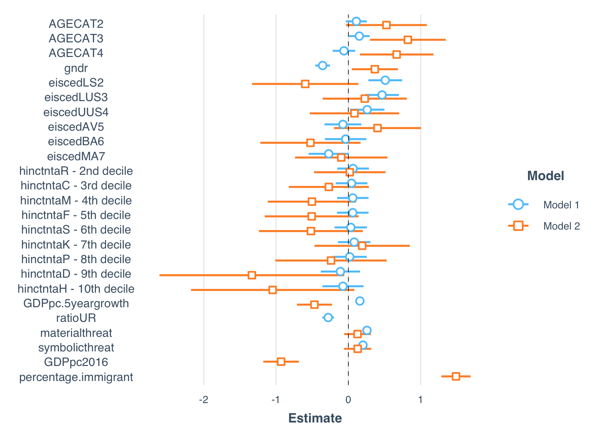
Discussion
As mentioned before we were mainly interested in knowing which selected factors might predict vote for RWP parties among the immigrant population.
The incidence of immigrants that vote for RWP parties is small but nonetheless, we find that:
as for natives, older immigrants are more likely to vote for RWP than younger ones.
Also, in line with the literature about natives voting for RWP (but not confirmed here):
immigrants with lower income are more susceptible to vote for RWP than those with higher income
immigrants in countries with lower average GDP per capita growth are more likely to vote for RWP than those living in countries with higher GDP per capita growth.
Blue = Natives
Orange = Immigrants

Slide 15
Discussion
Another interesting result : while native men are more likely to vote for RWP than native women, among immigrants it is women who are more likely to vote for RWP than men.
A surprising result is that immigrants who live in countries with higher percentage of immigrants are more likely to vote for RWP than those living in countries with lowest percentage of immigrants.
Blue = Natives
Orange = Immigrants

Slide 16
Conclusion
Despite some limitations…
( survey data, definition of immigrant, Israel with high “immigrant” population, considering European voters for RWP as a whole and not making differences between countries…)
… insight into the differences and similarities in factors which contribute to the vote of (1) native population and (2) immigrant population
This leads us to contend that the factors influencing the two groups are adequately varied to warrant further research, with particularly focus on building theory on the drivers of RWP voting for immigrant populations.

Slide 17
Thank you for your attention!
Any questions?

